Slide 1

OTA Updates with Real Time Diagnostics via CAN

Slide 2
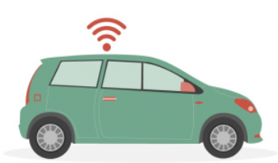
Project Members
Ahmed Ragab Mogoda
Amar Ragab Youssef
Mahmoud El Dinary Mohamed
Supervisor: Dr.Mohamed Mourad
Academic Year: 2024-2025
Presentation Date: [12/7/2025]

Slide 3

Problem Statement
Software‑Defined ECUs:
Modern vehicles rely on software‑defined ECUs for critical safety and performance functions.
Current Workflow Challenges:
Firmware flashing only in workshops → expensive downtime
Diagnostic tools are siloed and fragmented
Fault response is delayed due to manual processes
Resulting Consequences:
Increased maintenance costs and vehicle out‐of‐service time
Inconsistent workflows across service centers
Poor real‑time visibility into vehicle health

Slide 4
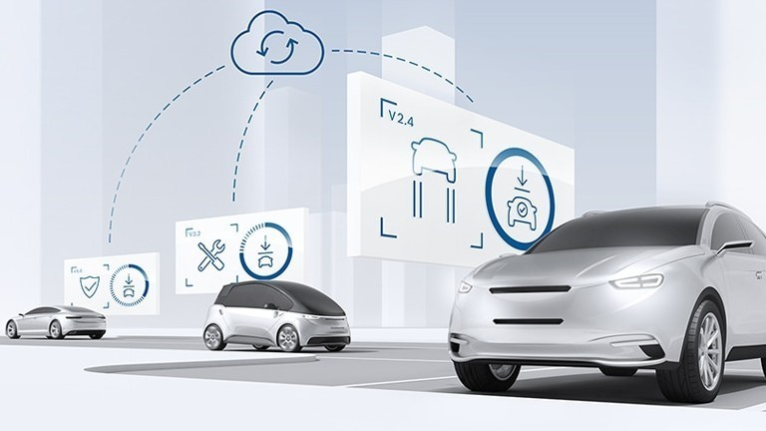
Problem Definition
Integrate real‑time health monitoring and secure OTA firmware updates over the existing CAN bus
Eliminate garage visits and unify diagnostics with maintenance processes

Slide 5

Objective
Develop an Integrated Vehicle-Control System
Real‑time streaming of sensor data (temperature, distance, speed) over CAN bus
Enable On‑Demand Diagnostics
Implement UDS protocol for session control, security access, and DTC read/clear
Secure, Fail‑Safe OTA Firmware Updates
Dual‑bank (App1/App2) bootloader on STM32.
Automatic rollback on failure
User‑Friendly Web Interface
Flask‑based GUI on Raspberry Pi
Live dashboard via Server‑Sent Events (SSE)

Slide 6
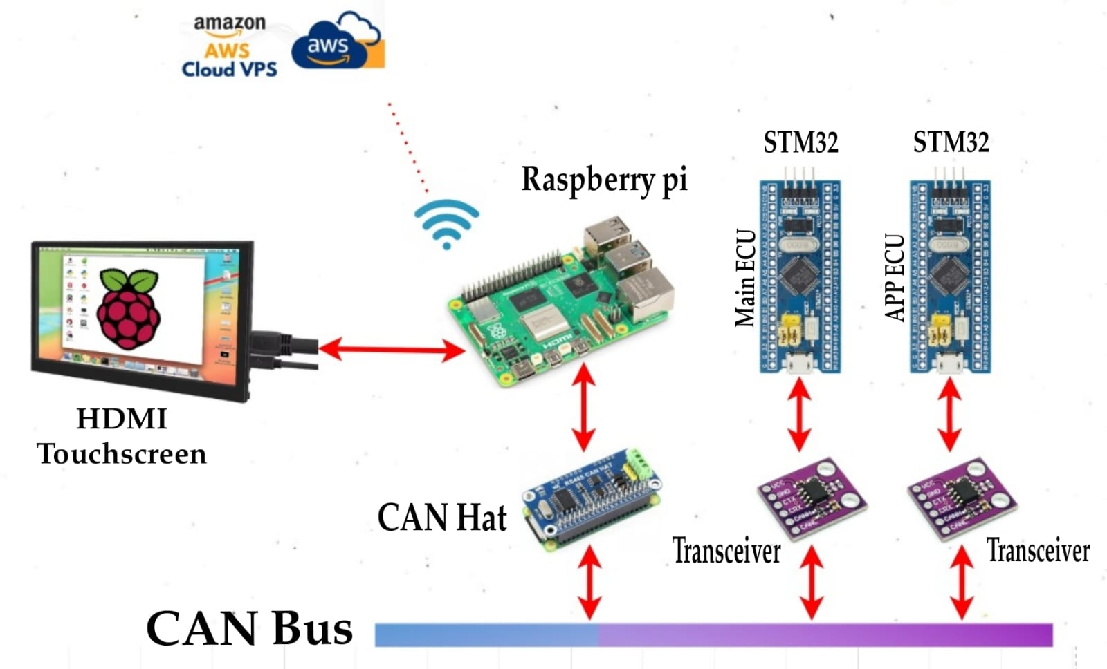
System Overview

Slide 7
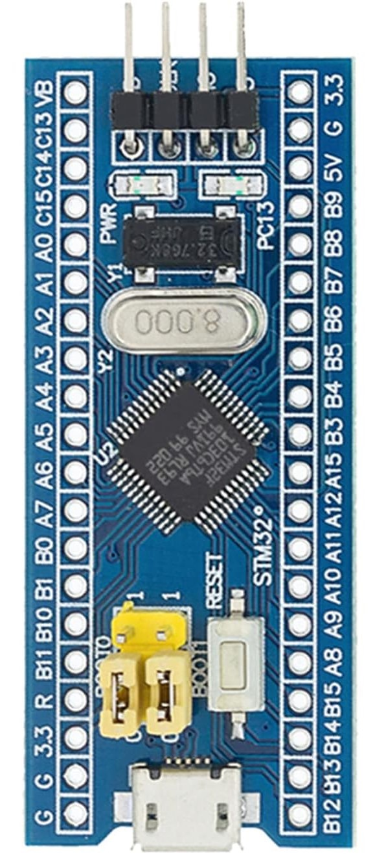
Main ECU (STM32F103)
Primary Role:
Manages secure Over-The-Air firmware updates and high-level diagnostics.
Software Stack:
STM32F103 microcontroller running FreeRTOS

Slide 8
Key FreeRTOS Tasks:
Receive
CANReceiveTask(): Receive CAN frames OTA triggers, control signals and diagnostics requests
Transmit
CANTransmitTask(): Transmit ACKs, status updates, and diagnostic responses
Monitor
ControlTask(): Monitor system state and enforce fallback/safety logic
Offer
DiagnosticsTask(): Offer UDS services (session control, security access, read/clear DTC)
OTA
OTAManagerTask(): Sets the metadata flag to request bootloader entry and Triggers a system reset so the bootloader takes over

Slide 9
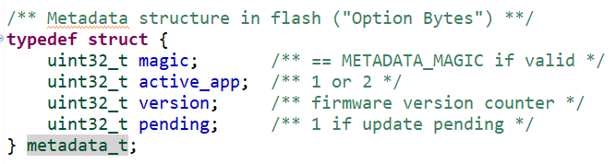
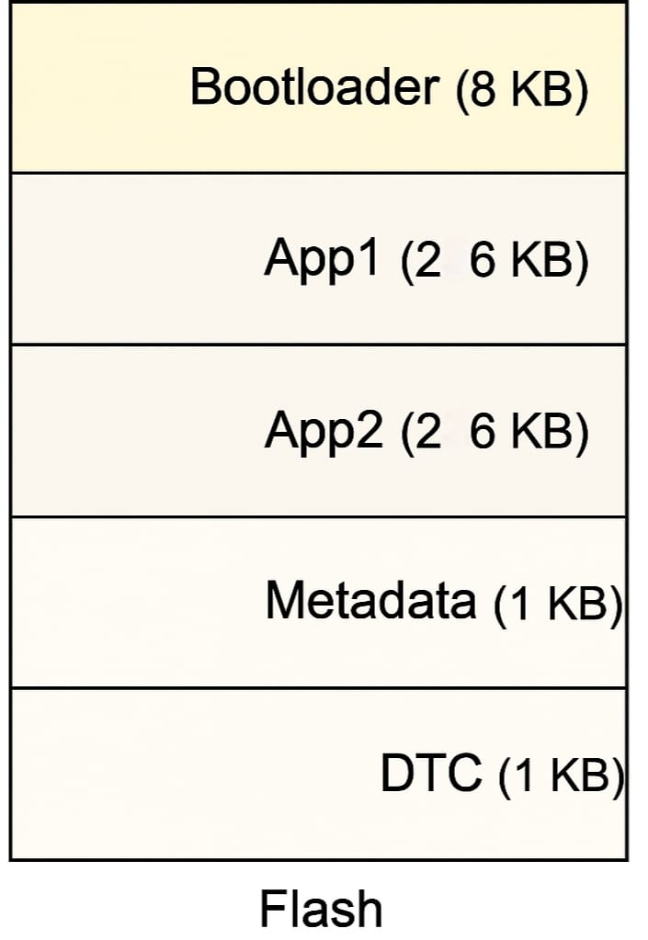
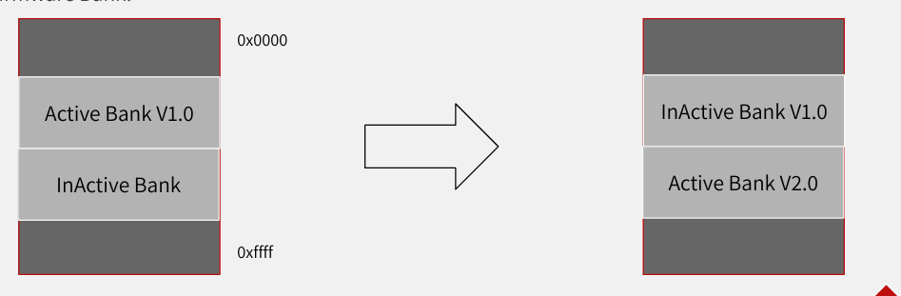
Bootloader

Slide 10
App ECU (STM32F103)
Primary Role:
Real‑time sensor acquisition, motor control.
Core Responsibilities:
Sensor Tasks:
UltrasonicTask: Samples distance and enqueues data.
TemperatureSensorTask: Reads LM35 temperature and enqueues data.
Motor Task:
Computes PWM duty cycle based on sensor inputs and safety limits.
Sends motor commands via CAN or direct PWM outputs.
Bluetooth Task:
Receives remote commands (e.g., drive, stop) and forwards them to the Control Task.
CAN Communication:
CAN Receive Task: Captures incoming CAN frames (control commands, diagnostic requests, OTA triggers).
CAN Transmit Task: Sends sensor telemetry, diagnostic responses, and acknowledgments.
CAN Bus Integration:
Shares the same bus at 500 kbps with Main ECU and Raspberry Pi’s MCP2515.

Slide 11
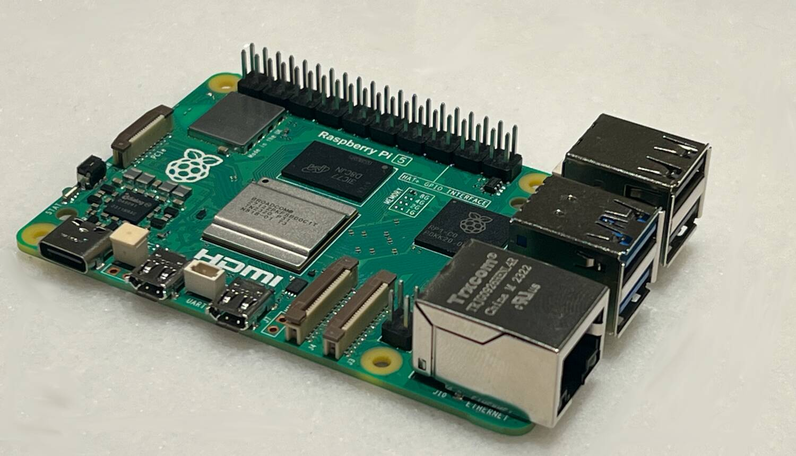
Raspberry Pi
Primary Role:
Acts as the user interface hub, OTA client, and CAN network gateway.
Hardware & Software Stack: Raspberry Pi 4 (2 GB RAM) with MCP2515 CAN transceiver
Operating System: Raspberry Pi OS
CAN Interface: SocketCAN driver configured at 500 kbps
Web Server: Flask application serving HTML/CSS/JS dashboard
Real‑Time Updates: Server‑Sent Events (SSE) for live telemetry

Slide 12
Core Components & Services
CAN Listener Service
Reads live CAN frames via candump or python-can
Forwards speed, temperature, distance to the web dashboard
OTA Client
Polls a cloud REST endpoint (e.g., AWS S3) for new firmware versions
Downloads signed firmware chunks and sends them over CAN to Main ECU
Diagnostics Client
Initiates UDS requests over CAN to read/clear DTCs
Displays diagnostic results in the dashboard
Flask Web Dashboard
Displays live charts for speed, temperature, and distance
Shows progress bar during OTA updates
Lists active DTC codes and system status

Slide 13
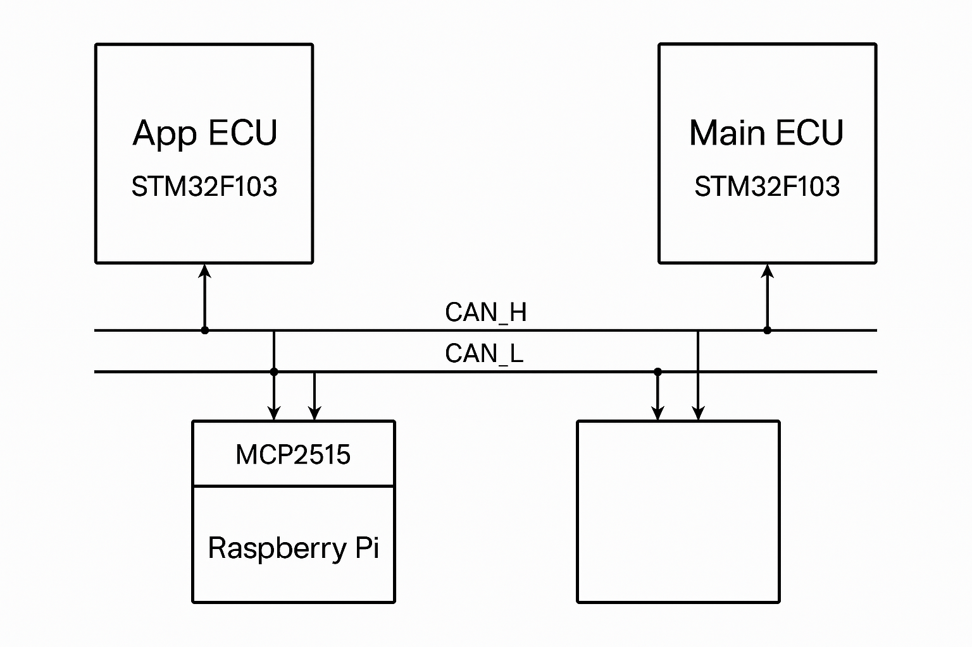
CAN Network Integration
All components (Raspberry Pi, Main ECU, App ECU) communicate over a shared CAN Bus operating at 500 kbps.
CAN ensures robust, real-time communication for control, diagnostics, and firmware updates.

Slide 14
Why CAN ?
Multi-Master Protocol : Each node can send data or receive data at any time
Half-duplex
fault-tolerant protocol that fits well with the requirements of automotive applications.
Simple
Low-cost
reliable
can be used in harsh environments. The CAN bus provides one point of entry for all the ECUs in the vehicle, which makes it easy to connect and diagnose.

Slide 15
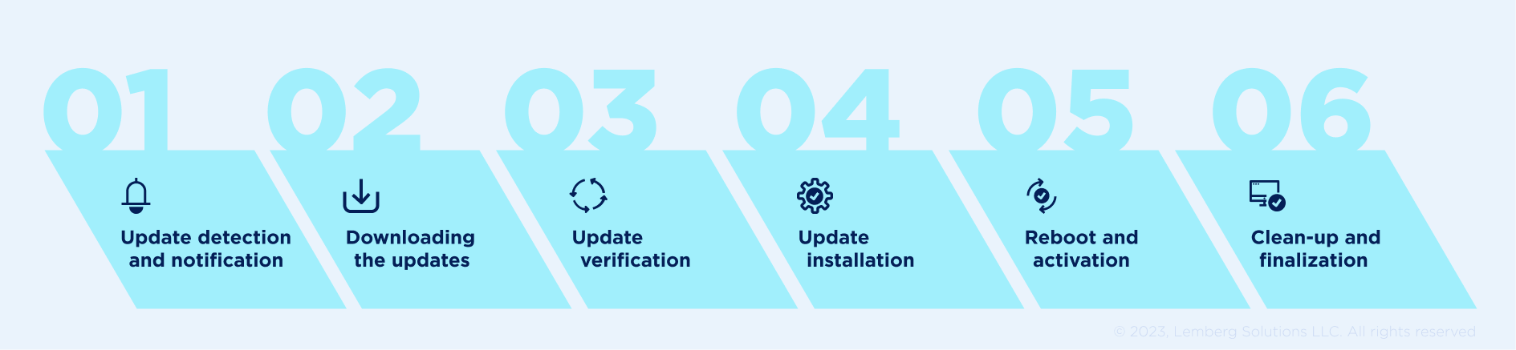
Over-The-Air (OTA) Firmware Updates

Slide 16
Workflow Overview
Version Check
Download
CAN Transfer
Bootloader Handoff
Bootloader Update
Activation & Verification

Slide 17
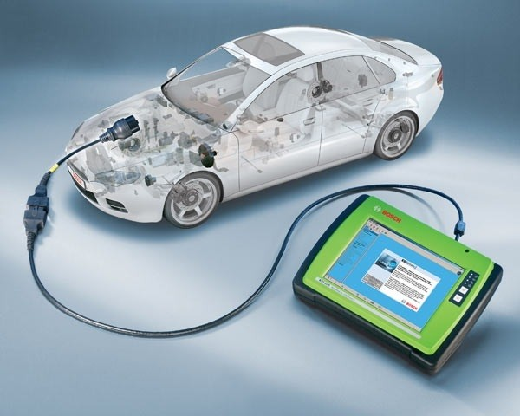
UDS Diagnostics
Unified Diagnostic Service (UDS) according to the ISO 14229 standard is a protocol used by diagnostic systems to communicate with ECUs in vehicles. The protocol is used to diagnose errors and reprogram ECUs. For example, it is possible to read and delete the fault memory of an ECU or to flash a new firmware on the ECU.

Slide 18
Why Vehicle Diagnostics Matter
Early Problem Detection
Continuous monitoring uncovers anomalies before they escalate into major failures.
Improved Fuel Efficiency
Identifies issues (e.g., misfires, sensor drift) that degrade mileage, leading to lower fuel costs.
Cost Savings
Addressing minor faults early prevents expensive repairs and reduces overall maintenance bills.
Enhanced Safety
Verifies critical systems (airbags, ABS) are operating correctly, ensuring peace of mind on the road.
Prolonged Vehicle Lifespan
Proactive maintenance reduces wear, extending the life and reliability of your car.

Slide 19
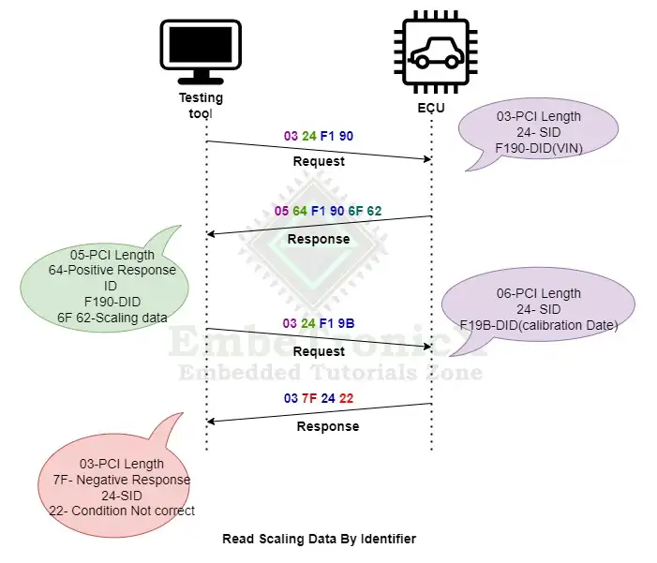
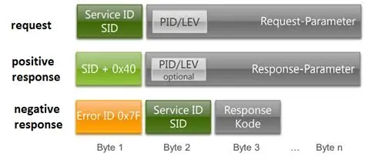
Diagnostics (UDS over CAN)

Slide 20
Diagnostic Workflow
Request Initiation
Diagnostics Client on Raspberry Pi sends UDS requests over CAN ID 0x7E0.
UDS Session Control
Main ECU’s InitDiagnosticsTask() processes 0x10 (StartDiagnosticSession).
Security Access
Optional challenge/response using service 0x27 for protected operations.
Read Data by Identifier
Service 0x22 to retrieve sensor values, firmware version, and status flags.
Read/Clear DTC
0x19 (ReadDTC) to list active fault codes stored in the 1 KB DTC region.
0x14 (ClearDTC) to erase codes after repair or reset.
Response Handling
Main ECU replies on CAN ID 0x7E8 with positive (0x50+SvcID) or negative responses.

Slide 21
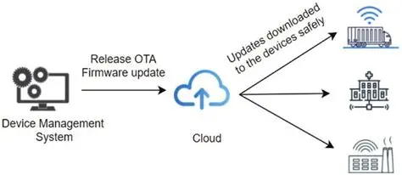
Cloud-Based Firmware Server
Purpose:
Host and serve firmware images securely for OTA updates.

Slide 22
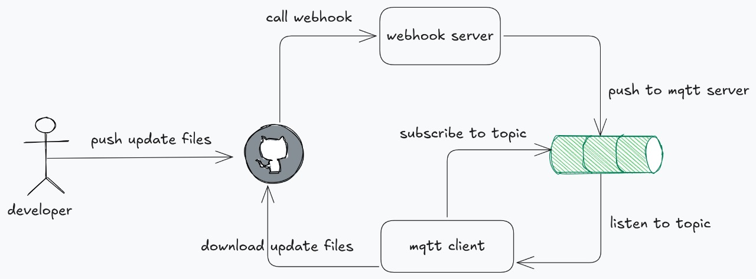
Workflow
Developer pushes updates to GitHub.GitHub launches a retail webhook.
The webhook server sends a notification to the MQTT server.
The MQTT server publishes the message to the appropriate topic.
The MQTT client listens to the topic, then pushes it to GitHub and applies it

Slide 23
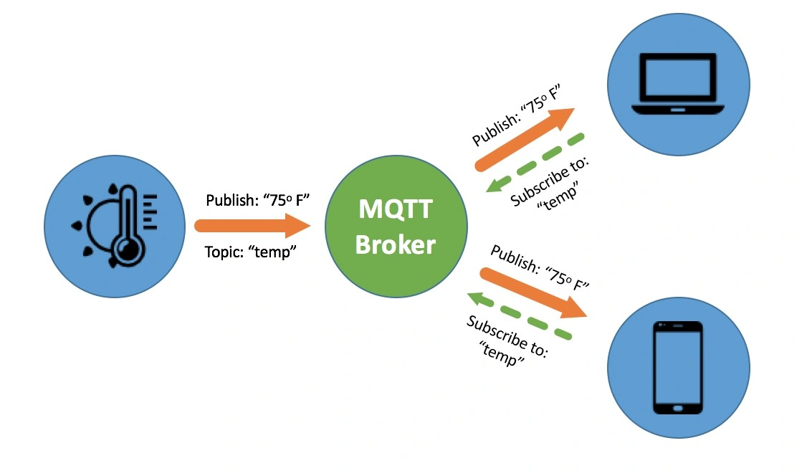
MQTT protocol
this diagram illustrates the basic architecture of the MQTT protocol using the "publish/subscribe" communication model.

Slide 24
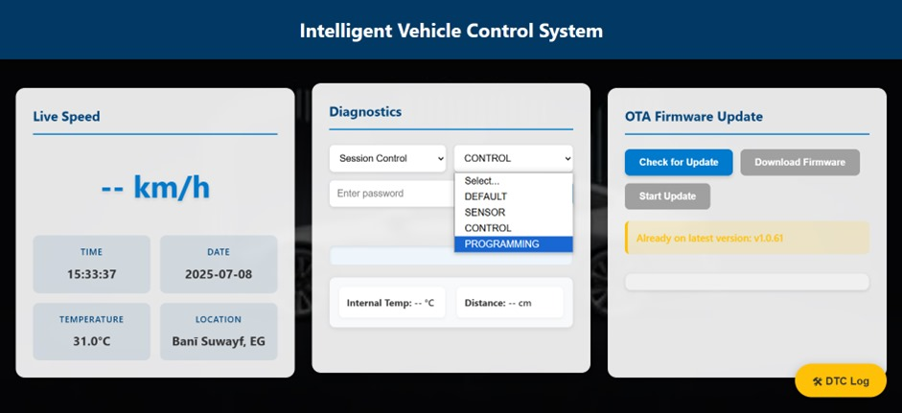
Web Dashboard & User Interface
Provide intuitive, real‑time visualization of vehicle telemetry, diagnostics, and OTA progress

Slide 25
Technology Stack
Flask (Python) as the backend web server
HTML5, CSS3, JavaScript for responsive UI
Server‑Sent Events (SSE) for live data streaming
Chart.js (or similar) for dynamic charts

Slide 26
Key Features
Live Telemetry Panels
Speed Gauge: Updates on each CAN frame (0x401)
Temperature & Distance Charts: Time‑series plots of LM35 and ultrasonic readings
Diagnostics Section
Active DTC List: Retrieved via UDS ReadDTC service
Clear DTC Button: Triggers UDS ClearDTC request
OTA Update Workflow
Version Indicator: Shows current vs. available firmware version
Progress Bar: Reflects chunked update status in real time
Start/Cancel Controls: User‑initiated OTA triggers
System Status & Logs
Connection Health: Indicates CAN bus and ECU connectivity
Event Log: Scrollable list of recent diagnostics, errors, and update events

Slide 27
Results & Demo
Real-Time Control: CAN RX → Motor PWM in <2 ms (jitter <100 µs)
Diagnostics Performance: UDS ReadDTC in ~5 ms, ClearDTC in ~4 ms
Fast OTA Updates: 26 KB firmware transferred and verified in ~0.54 s
Robust Reliability: Automatic rollback on signature failure or power loss
Live Dashboard: 50 Hz telemetry (speed, temp, distance) and real-time OTA progress via SSE

Slide 28
Conclusion
Unified real-time diagnostics & secure OTA over CAN in a single system
Deterministic control (<2 ms) and rapid firmware updates (~0.54 s)
RSA-protected, fail-safe updates with automatic rollback
Intuitive web dashboard removes need for workshop visits

Slide 29
Any Questions?

Slide 30


Thanks

